Slide 1
The SportsStore Project (continued)

Slide 2
Adding URL Routing
Most applications need to show different content to the user at different times.
In the case of the SportsStore application, when the user clicks one of the Add To Cart buttons, they should be shown a detailed view of their selected products and given the chance to start the checkout process.
Angular supports a feature called URL routing, which uses the current URL displayed by the browser to select the components that are displayed to the user.
This is an approach that makes it easy to create applications whose components are loosely coupled and easy to change without needing corresponding modifications elsewhere in the applications.
URL routing also makes it easy to change the path that a user follows through an application.

Slide 3
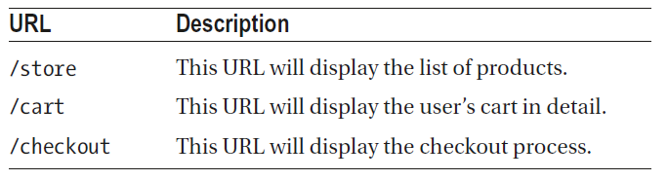
Adding URL Routing (continued)
For the SportsStore application, we are going to add support for three different URLs, which are described in the table below. This is a simple configuration, but the routing system has a lot of features.
In the sections that follow, we create placeholder components for the SportsStore cart and order checkout stages and then integrate them into the application using URL routing.
Once the URLs are implemented, we will return to the components and add more useful features.

Slide 4
Creating the Cart Detail and Checkout Components
Before adding URL routing to the application, we need to create the components that will be displayed by the /cart and /checkout URLs.
We only need some basic placeholder content to get started, just to make it obvious which component is being displayed.
Let’s start by creating a file called cartDetail.component.ts in the src/app/store folder and add the following code:
import { Component } from '@angular/core';
@Component({
template: `<div><h3 class="bg-info p-1 text-white">Cart Detail Component</h3></div>`
})
export class CartDetailComponent { }

Slide 5
Creating the Cart Detail and Checkout Components (continued)
Next, let’s create a file called checkout.component.ts in the src/app/store folder and add the following code:
import { Component } from '@angular/core';
@Component({
template: `<div><h3 class="bg-info p-1 text-white">Checkout Component</h3></div>`
})
export class CheckoutComponent { }

Slide 6
Creating the Cart Detail and Checkout Components (continued)
Now, let’s register these components by modifying the store.module.ts file in the src/app/store folder:
import { NgModule } from '@angular/core';
import { BrowserModule } from '@angular/platform-browser';
import { FormsModule } from '@angular/forms';
import { ModelModule } from '../model/model.module';
import { StoreComponent } from './store.component';
import { CounterDirective } from './counter.directive';
import { CartSummaryComponent } from './cartSummary.component';
import { CartDetailComponent } from './cartDetail.component';
import { CheckoutComponent } from './checkout.component';
@NgModule({
imports: [ModelModule, BrowserModule, FormsModule],
declarations: [StoreComponent, CounterDirective, CartSummaryComponent,
CartDetailComponent, CheckoutComponent],
exports: [StoreComponent, CounterDirective, CartSummaryComponent,
CartDetailComponent, CheckoutComponent]
})
export class StoreModule { }

Slide 7
Creating and Applying the Routing Configuration
Now that we have a range of components to display, the next step is to create the routing configuration that tells Angular how to map URLs into components.
Each mapping of a URL to a component is known as a URL route or just a route.

Slide 8
Creating and Applying the Routing Configuration (continued)
Modify the app.module.ts file in the src/app folder to create the Routing Configuration:
import { BrowserModule } from '@angular/platform-browser';
import { NgModule } from '@angular/core';
import { AppComponent } from './app.component';
import { StoreModule} from './store/store.module';
import { StoreComponent } from './store/store.component';
import { CartDetailComponent } from './store/cartDetail.component';
import { CheckoutComponent } from './store/checkout.component';
import { RouterModule } from '@angular/router';
@NgModule({
declarations: [AppComponent],
imports: [BrowserModule, StoreModule,
RouterModule.forRoot([
{path: 'store', component: StoreComponent},
{path: 'cart', component: CartDetailComponent},
{path: 'checkout', component: CheckoutComponent},
{path: '**', redirectTo: '/store'}
])],
providers: [],
bootstrap: [AppComponent]
})
export class AppModule { }

Slide 9
Creating and Applying the Routing Configuration (continued)
The RouterModule.forRoot method is passed a set of routes, each of which maps a URL to a component.
The first three routes in the listing match the URLs from Table shown above.
The final route is a wildcard that redirects any other URL to /store, which will display StoreComponent.
When the routing feature is used, Angular looks for the router-outlet element, which defines the location in which the component that corresponds to the current URL should be displayed.

Slide 10
Creating and Applying the Routing Configuration (continued)
Modify the app.component.ts file in the src/app folder so that we replace the store element in the root component’s template with the router-outlet element:
import { Component } from '@angular/core';
@Component({
selector: 'app',
template: `<router-outlet></router-outlet>`
})
export class AppComponent {}

Slide 11
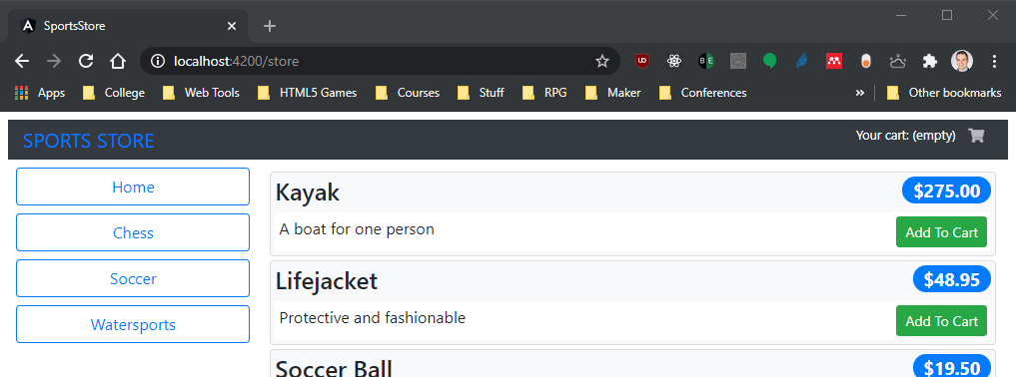
Creating and Applying the Routing Configuration (continued)
Angular will apply the routing configuration when you save the changes and the browser reloads the HTML document.
The content displayed in the browser window hasn’t changed, but if you examine the browser’s URL bar, you will be able to see that the routing configuration has been applied:

Slide 12
Navigating Through the Application
With the routing configuration in place, it is time to add support for navigating between components by changing the browser’s URL.
The URL routing feature relies on a JavaScript API provided by the browser, which means the user can’t simply type the target URL into the browser’s URL bar.
Instead, the navigation has to be performed by the application, either by using JavaScript code in a component or other building block or by adding attributes to HTML elements in the template.

Slide 13
Navigating Through the Application (continued)
When the user clicks one of the Add To Cart buttons, the cart detail component should be shown, which means that the application should navigate to the /cart URL.
Modify the store.component.ts file in the app/src/store folder to add navigation to the component method that is invoked when the user clicks the button:
import { Component } from '@angular/core';
import { Product } from '../model/product.model';
import { ProductRepository } from '../model/product.repository';
import { Cart } from '../model/cart.model';
import { Router } from '@angular/router’;
@Component({
selector: 'store',
templateUrl: 'store.component.html'
})
export class StoreComponent {
public selectedCategory = null;
public productsPerPage = 4;
public selectedPage = 1;
constructor(private repository: ProductRepository,
private cart: Cart,
private router: Router) { }
...

Slide 14
Navigating Through the Application (continued)
...
get pageCount(): number {
return Math.ceil(this.repository.getProducts(this.selectedCategory).length / this.productsPerPage);
}
addProductToCart(product: Product): void {
this.cart.addLine(product);
this.router.navigateByUrl('/cart');
}
}
The constructor has a Router parameter, which is provided by Angular through the dependency injection feature when a new instance of the component is created.
In the addProductToCart method, the Router.navigateByUrl method is used to navigate to the /cart URL.

Slide 15
Navigating Through the Application (continued)
Navigation can also be done by adding the routerLink attribute to elements in the template.
Modify the cartSummary.component.html file in the src/app/store folder so that the routerLink attribute is applied to the cart button in the cart summary component’s template:
<div class="float-right">
<small>
Your cart:
<span *ngIf="cart.itemCount > 0">
{{ cart.itemCount }} item(s)
{{ cart.cartPrice | currency: "USD":"symbol":"2.2-2" }}
</span>
<span *ngIf="cart.itemCount == 0">
(empty)
</span>
</small>
<button
class="btn btn-sm bg-dark text-white"
[disabled]="cart.itemCount == 0" routerLink='/cart'>
<i class="fa fa-shopping-cart"></i>
</button>
</div>

Slide 16
Navigating Through the Application (continued)
To add support for the routerLink attribute, the RouterModule module must be imported into the feature module.
Modify the store.module.ts file in the src/app/store folder with the following highlighted code:
import { NgModule } from '@angular/core';
import { BrowserModule } from '@angular/platform-browser';
import { FormsModule } from '@angular/forms';
import { ModelModule } from '../model/model.module';
import { StoreComponent } from './store.component';
import { CounterDirective } from './counter.directive';
import { CartSummaryComponent } from './cartSummary.component';
import { CartDetailComponent } from './cartDetail.component';
import { CheckoutComponent } from './checkout.component';
import { RouterModule } from '@angular/router';
@NgModule({
imports: [ModelModule, BrowserModule, FormsModule, RouterModule],
declarations: [StoreComponent, CounterDirective, CartSummaryComponent,
CartDetailComponent, CheckoutComponent],
exports: [StoreComponent, CounterDirective, CartSummaryComponent,
CartDetailComponent, CheckoutComponent]
})
export class StoreModule { }

Slide 17
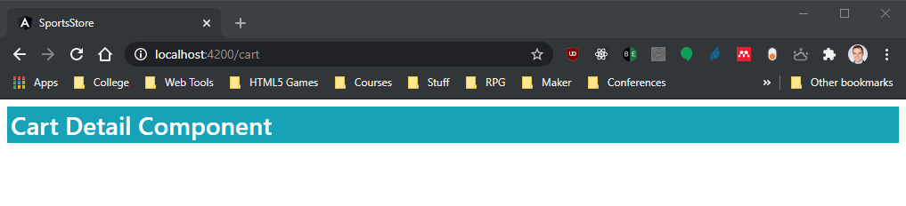
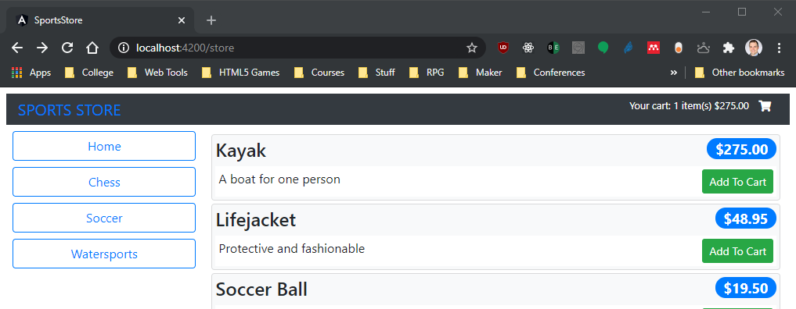
Navigating Through the Application (continued)
To see the effect of the navigation, save the changes of the files, and once the browser has reloaded the HTML document, click one of the Add To Cart buttons.
The browser will navigate to the /cart URL:

Slide 18
Guarding the Routes
Remember that navigation can be performed only by the application.
If you change the URL directly in the browser’s URL bar, the browser will request the URL you enter from the web server.
The Angular development server that is responding to HTTP requests will respond to any URL that doesn’t correspond to a file by returning the contents of index.html.
This is generally a useful behavior because it means you won’t receive an HTTP error when the browser’s reload button is clicked.
But it can cause problems if the application expects the user to navigate through the application following a specific path.

Slide 19
Guarding the Routes (continued)
As an example, if you click one of the Add To Cart buttons and then click the browser’s reload button, the HTTP server will return the contents of the index.html file, and Angular will immediately jump to the cart detail component, skipping over the part of the application that allows the user to select products.
For some applications, being able to start using different URLs makes sense, but if that’s not the case, then Angular supports route guards, which are used to govern the routing system.

Slide 20
Guarding the Routes (continued)
To prevent the application from starting with the /cart or /order URL, we will create a file called storeFirst.guard.ts in the src/app folder and defined the class shown in the following code listing:
import { Injectable } from '@angular/core';
import { ActivatedRouteSnapshot, RouterStateSnapshot, Router } from '@angular/router';
import { StoreComponent } from './store/store.component';
@Injectable()
export class StoreFirstGuard {
private firstNavigation = true;
constructor(private router: Router) { }
canActivate(route: ActivatedRouteSnapshot, state: RouterStateSnapshot): boolean
{
if (this.firstNavigation)
{
this.firstNavigation = false;
if (route.component !== StoreComponent)
{
this.router.navigateByUrl('/');
return false;
}
}
return true;
}
}

Slide 21
Guarding the Routes (continued)
There are different ways to guard routes, and this is an example of a guard that prevents a route from being activated, which is implemented as a class that defines a canActivate method.
The implementation of this method uses the context objects that Angular provides that describe the route that is about to be navigated to and checks to see whether the target component is a StoreComponent.
If this is the first time that the canActivate method has been called and a different component is about to be used, then the Router.navigateByUrl method is used to navigate to the root URL.
The @Injectable decorator has been applied in the code listing because route guards are services.

Slide 22
Guarding the Routes (continued)
Modify the app.module.ts file in the src/app folder to register the guard as a service. Here, we use the root module’s providers property to guard each route using the canActivate property:
import { BrowserModule } from '@angular/platform-browser';
import { NgModule } from '@angular/core';
import { AppComponent } from './app.component';
import { StoreModule} from './store/store.module';
import { StoreComponent } from './store/store.component';
import { CartDetailComponent } from './store/cartDetail.component';
import { CheckoutComponent } from './store/checkout.component';
import { RouterModule } from '@angular/router';
import { StoreFirstGuard } from './storeFirst.guard';
@NgModule({
declarations: [AppComponent],
imports: [BrowserModule, StoreModule,
RouterModule.forRoot([
{path: 'store', component: StoreComponent, canActivate: [StoreFirstGuard]},
{path: 'cart', component: CartDetailComponent, canActivate: [StoreFirstGuard]},
{path: 'checkout', component: CheckoutComponent, canActivate: [StoreFirstGuard]},
{path: '**', redirectTo: '/store'}
])],
providers: [StoreFirstGuard],
bootstrap: [AppComponent]
})
export class AppModule { }

Slide 23
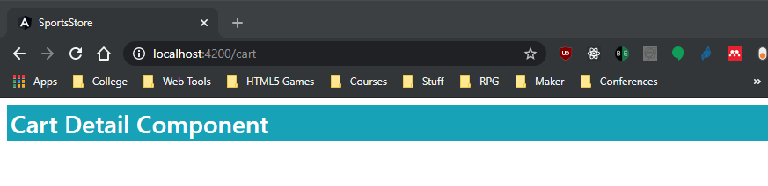
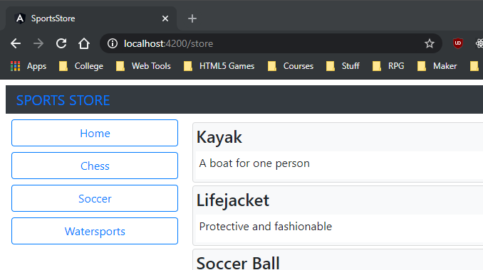
Guarding the Routes (continued)
If you reload the browser after clicking one of the Add To Cart buttons now, then you will see the browser is automatically directed back to safety:

Slide 24
Completing the Cart Detail Feature
Now that the application has navigation support, it is time to complete the view that details the contents of the user’s cart.
First, we remove the inline template in the cartDetail.component.ts file in the src/app/store folder from the cart detail component, and we specify an external template in the same directory. Then, we add a Cart parameter to the constructor, which will be accessible in the template through a property called cart:
import { Component } from '@angular/core';
import { Cart } from './../model/cart.model';
@Component({
template: `cartDetail.component.html`
})
export class CartDetailComponent {
constructor(public cart: Cart) {}
}

Slide 25
Completing the Cart Detail Feature (continued)
To complete the cart detail feature, Create an HTML file called cartDetail.component.html in the src/app/store and add the following code:
<div class="container-fluid">
<div class="row">
<div class="col bg-dark text-white">
<a class="navbar-brand">SPORTS STORE</a>
</div>
</div>
<div class="row">
<div class="col mt-2">
<h2 class="text-center">Your Cart</h2>
<table class="table table-bordered table-striped p-2">
<thead>
<tr>
<th>Quantity</th>
<th>Product</th>
<th class="text-right">Price</th>
<th class="text-right">Subtotal</th>
</tr>
</thead>
<tbody>
<tr *ngIf="cart.lines.length == 0">
<td colspan="4" class="text-center">Your cart is empty</td>
</tr>
<tr *ngFor="let line of cart.lines">
<td>
<input
type="number" class="form-control-sm" style="width: 5em"
[value]="line.quantity"
(change)="cart.updateQuantity(line.product, $event.target.value)"/>
</td>
<td>{{ line.product.name }}</td>
<td class="text-right">
{{ line.product.price | currency: "USD":"symbol":"2.2-2" }}
</td>
<td class="text-right">
{{ line.lineTotal | currency: "USD":"symbol":"2.2-2" }}
</td>

Slide 26
Completing the Cart Detail Feature (continued)
<td class="text-center">
<button class="btn btn-sm btn-danger"
(click)="cart.removeLine(line.product._id)">
Remove
</button>
</td>
</tr>
</tbody>
<tfoot>
<tr>
<td colspan="3" class="text-right">Total:</td>
<td class="text-right">
{{ cart.cartPrice | currency: "USD":"symbol":"2.2-2" }}
</td>
</tr>
</tfoot>
</table>
</div>
</div>
<div class="row">
<div class="col">
<div class="text-center">
<button class="btn btn-primary m-1" routerLink="/store">
Continue Shopping
</button>
<button
class="btn btn-secondary m-1" routerLink="/checkout"
[disabled]="cart.lines.length == 0">
Checkout
</button>
</div>
</div>
</div>
</div>

Slide 27
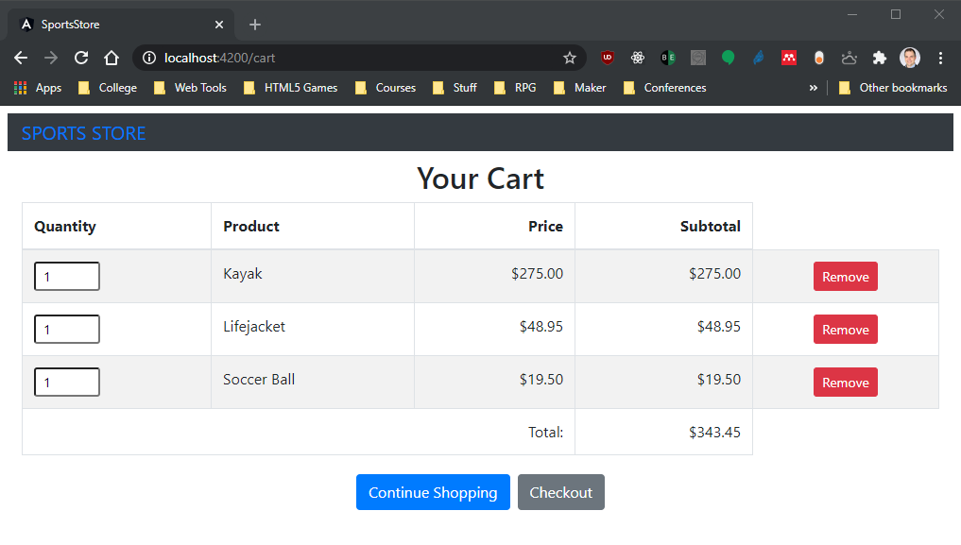
Completing the Cart Detail Feature (continued)
The template above displays a table showing the user’s product selections.
For each product, there is an input element that can be used to change the quantity, and there is a Remove button that deletes it from the cart.
There are also two navigation buttons that allow the user to return to the list of products or continue to the checkout process

